Slide 1
String Matching
Rabin-Karp Algorithm

Slide 2
Pattern Matching
Given a text string T[0..n-1] and a pattern P[0..m-1], find all occurrences of the pattern within the text.
Example: T = 000010001010001 and P = 0001, the occurrences are:
first occurrence starts at T[1]
second occurrence starts at T[5]
third occurrence starts at T[11]

Slide 3
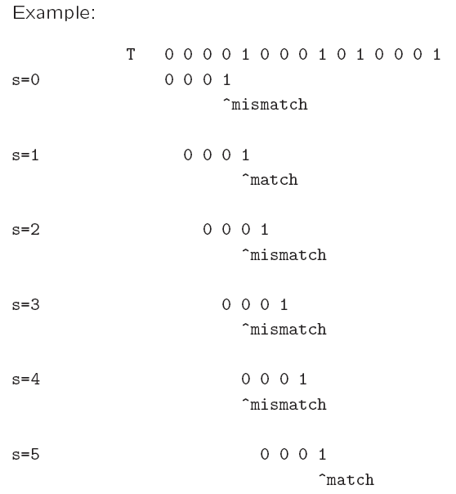
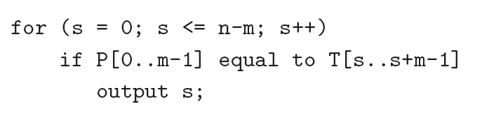
Naïve algorithm
Worst-case running time = O(nm).

Slide 4
Rabin-Karp Algorithm
Key idea:
think of the pattern P[0..m-1] as a key, transform (hash) it into an equivalent integer p
Similarly, we transform substrings in the text string T[] into integers
For s=0,1,…,n-m, transform T[s..s+m-1] to an equivalent integer t_{s}
The pattern occurs at position s if and only if p=t_{s}
If we compute p and t_{s} quickly, then the pattern matching problem is reduced to comparing p with n-m+1 integers

Slide 5
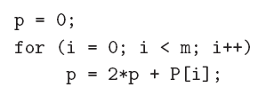
Rabin-Karp Algorithm …
How to compute p?
p = 2^{m-1} P[0] + 2^{m-2} P[1] + … + 2 P[m-2] + P[m-1]
Using horner’s rule
This takes O(m) time, assuming each arithmetic operation can be done in O(1) time.

Slide 6
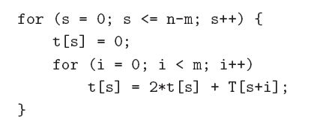
Rabin-Karp Algorithm …
Similarly, to compute the (n-m+1) integers t_{s} from the text string
This takes O((n – m + 1) m) time, assuming that each arithmetic operation can be done in O(1) time.
This is a bit time-consuming.

Slide 7
Rabin-Karp Algorithm
lets m = 3
t[0] = 2² * T[0] + 2 * T[1] + T[2]
t[1] = 2² * T[1] + 2 * T[2] + T[3]
= 2(2 * T[1] + T[2] + 2² T[0] - 2² T[0]) + T[3]
= 2(t[0] - 2² T[0]) + T[3]
t[s] = 2(t[s-1] - 2^{m-1} T[s-1]) + T[s+m-1]
= 2(t[s-1] - offset * T[s-1]) + T[s+m-1]

Slide 8
Rabin-Karp Algorithm
A better method to compute the integers is:
p = 0
for (i = 0; i < m ; i++)
p = 2 * p + P[i]
offset = 1
for (i = 1; i <= m-1; i++)
offset = offset * 2
t[0] = 0
for (i=0; i<m; i ++)
t[0] = 2 * t[0] + T[i]
for (s = 1; s<=n-m; s++)
t[s] = 2(t[s-1] - offset * T[s-1]) + T[s+m-1]
This takes O(n+m) time, assuming that each arithmetic operation can be done in O(1) time.

Slide 9
Problem
The problem with the previous strategy is that when m is large, it is unreasonable to assume that each arithmetic operation can be done in O(1) time.
In fact, given a very long integer, we may not even be able to use the default integer type to represent it.
Therefore, we will use modulo arithmetic. Let q be a prime number so that 2q can be stored in one computer word.
This makes sure that all computations can be done using single-precision arithmetic.

Slide 10
Modular Arithmetic
Common rules for modular arithmetic,
(a+b)%M = (a%M + b%M)%M
(a*b)%M = ((a%M) * (b%M))%M
Ex, (-7)%3 = (-7+9)%3 = 2%3 = 2

Slide 11
Pseudocode with modular arithmetic
p = 0
for (i = 0; i < m ; i++)
p = (2 * p + P[i]) % q
offset = 1
for (i = 1; i <= m-1; i++)
offset = (offset * 2) % q
t[0] = 0
for (i=0; i<m; i ++)
t[0] = (2 * t[0] + T[i]) % q
for (s = 1; s<=n-m; s++)
t[s] = (2 * (t[s-1] - (offset * T[s-1])% q + T[s+m-1] )) % q

Slide 12
Critical Checking
Once we use the modulo arithmetic, when p=t_{s} for some s, we can no longer be sure that P[0 .. M-1] is equal to T[s .. S+ m -1 ], e.g, 14%7 == 0 and 7%7==0, so two strings (14 value, 7 value) will be considered same.
Therefore, after the equality test p = t_{s}, we should compare P[0..m-1] with T[s..s+m-1] character by character to ensure that we really have a match.
So the worst-case running time becomes O(nm), but it avoids a lot of unnecessary string matchings in practice.

